Slide 1
Machine Learning – some technical details
Feature Engineering
Learning as optimization
Loss / Cost function
One-hot encoding
Softmax Normalization
Cross Entropy (log-loss),
KL-divergence
ROC Curve
Overfitting
Regularization
Ridge Regression, LASSO, Elastic Net
Back Propagation
Stochastic Gradient Descent
Batch-processing, Mini-batch, batch-size,
Vanishing Gradient Problem
Dynamic learning rate, ADAM optimizer

Slide 2
Machine Learning Taxonomy (examples):
Supervised ML
Regression (predictions/forecasting – market, weather, popularity, life expectancy, etc.)
Classification (image, diagnostics, fraud detection, customer retention, etc.)
Unsupervised ML
Dimensionality Reduction (structure discovery, PCA (Principal Component Analysis),
feature extraction, meaningful compression, data visualization)
Clustering (Recommender Systems, Customer Segmentation, Targeted Marketing)
Language Translation
Reinforcement Learning
Real-Time Decisions (Games, Self-Driving Cars, etc.)
Robotics (complex real-time navigation and movement)
Learning tasks and skills
Games

Slide 3
Feature Engineering
Feature - measurable property or characteristic of the data.
Feature engineering - prepare data for ML algorithms to work:
- clean data,
- extract / select data
- convert data to numeric vectors, clean
- transform - scale/normalize (rotate/rescale/crop image, etc.)
- transform – concentrate (for example, PCA – Principal Component Analysis,
- impute (shift, rotate, mirror, rescale images, add fake data to minority class to decrease imbalance, etc. )
- make composite features
- add generated features

Slide 4
Learning as Optimization Problem.
Models may be very small (Logistic Regression – just 2 coefficients),
or very big (~170 Bln weights and biases), or any size in between.
Training (fitting) the model means finding values (weights) of its internal parameters which reduce the error of the model (the difference between the output of the model – and actual data). This error is usually called "Loss Function" or "Cost Function".
We can start training with some random initial values, or sometimes we can find good approximate values to start with.

Slide 5
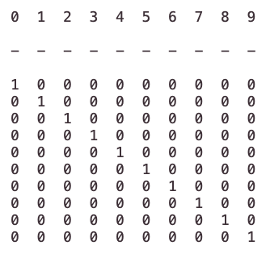
Neural Network For Classification
Learns One-Hot Representation

Slide 6
Typically the output of a classifier network uses softmax activation function
to squash output into interval [0,1]
and to ensure that sum of outputs is exactly 1.
Then (after softmax) the cross-entropy is used to calculate the loss (error).
softmax:
cross-entropy loss:

Slide 7
Soft-Max
Normalization
Target /Label
Cross-Entropy (log loss) Error
y
Y_{t}
-ln(0.946) = ~ 0.055
7
0.946
1
+
4
0.047
0
-ln(1-0.047) = ~ 0.048
0.109
+
2
0.006
0
-ln(1-0.006) = ~ 0.006
One-hot
encoding
def CrossEntropy(Yt, y):
if Yt == 1:
return -log(y)
return -log(1 - y)

Slide 8
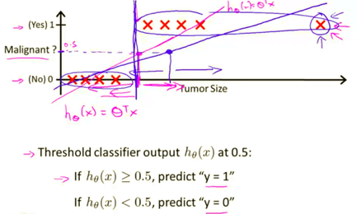
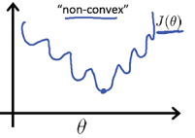
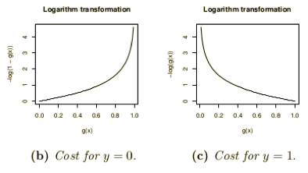
Why Mean Squared Error (MSE) is not good for classification?
From Andrew Ng’s Machine Learning course (see on YouTube or Coursera)
First, MSE can force conversion to a wrong answer. On the picture to the right you can see how adding data points with big tumor sizes will shift the transition point toward larger sizes, thus changing diagnosis for some cases.
Second reason against MSE is that MSE loss function tend to be
non-convex - have multiple local minima, thus making it difficult to converge.
Finally, Cross-Entropy Error function gives bigger gradients and better conversion.

Slide 9
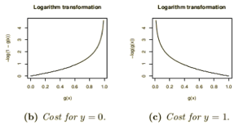
Cross-entropy loss = log loss
- https://www.youtube.com/watch?v=ErfnhcEV1O8
- http://neuralnetworksanddeeplearning.com/chap3.html
- http://ml-cheatsheet.readthedocs.io/en/latest/loss_functions.html
In machine learning (logistic regression, neural networks) cross-entropy (CE) is used to measure the difference between the actual and desired output. Note that this CE is different from CE used in information theory.
Suppose we have a network which solves classification problem and has one output node (neuron) which outputs a number “a” between 0 and 1. The desired output of binary classification (label y) should be either 0 or 1.
We define CrossEntropy() function as following:
def CrossEntropy(y, a):
if y == 1:
return -log(a)
return -log(1 - a)
Note how this function returns very big number if y and a differ. For example, if y == 1 and a is close to 0, then –log(a) will be a very large positive number. But when a is close to 1, then the output will be close to zero. So CE loss function gives big gradients – and makes learning faster.
Note that we can write the same logic without if/else:
def CrossEntropy(y, a):
return –( y*log(a) + (1-y)*ln(1-a) )

Slide 10
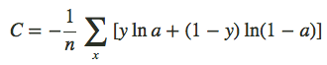
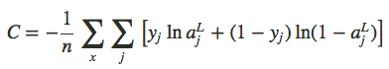
If we have “n” training samples, then the total Cross-Entropy will be simply a sum of them:
And if the output is several nodes (not just one) – then we sum over all of them:

Slide 11
Note that this formula:
C=−(1/n)∑( y*ln(a) + (1−y)*ln(1−a) )
can be also rewritten using notation (a1=a, a2=1-a, y1=y, y2=1-y) as:
C=−(1/n)∑( y₁*ln(a₁) + y₂*ln(a₂) )
or
C=−(1/n)∑∑ y_{j}*ln(a_{j})
where we sum by j (0,1) and by number of samples “n”.
In this form it looks the same as formula for log-likelihood or cross-entropy
in information theory (see next slides).
But note that in information theory the characters in the formula have different meaning and the formula is used for different domain (probability distributions, likelihood, independent variables, gaussian distribution, etc).
See also here:
https://stats.stackexchange.com/questions/223799/different-definitions-of-the-cross-entropy-loss-function/224491#224491

Slide 12
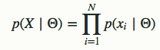
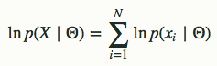
Log-likelihood
The likelihood (L) of a parameter value (or vector of parameter values), θ, given outcomes x, is equal to the probability (density) assumed for those observed outcomes given those parameter values.
For many applications, the natural logarithm of the likelihood function, called the log-likelihood, is more convenient to work with. Because the logarithm is a monotonically increasing function, the logarithm of a function achieves its maximum value at the same points as the function itself, and hence the log-likelihood can be used in place of the likelihood in maximum likelihood estimation and related techniques.
Finding the maximum of a function often involves taking the derivative of a function and solving for the parameter being maximized, and this is often easier when the function being maximized is a log-likelihood rather than the original likelihood function.
For example, some likelihood functions are for the parameters that explain a collection of statistically independent observations. In such a situation, the likelihood function factors into a product of individual likelihood functions. The logarithm of this product is a sum of individual logarithms, and the derivative of a sum of terms is often easier to compute than the derivative of a product.
L = P(x | θ)
ln(L)

Slide 13
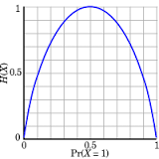
Shannon entropy
Claude Shannon (1916-2001)
American mathematician, electrical engineer, and cryptographer
known as "the father of information theory".
Landmark paper:"A Mathematical Theory of Communication" (1948)
- https://en.wikipedia.org/wiki/Claude_Shannon
- https://en.wikipedia.org/wiki/Entropy_(information_theory)
- https://www.quora.com/What-is-an-intuitive-explanation-of-the-concept-of-entropy-in-information-theory
Shannon entropy provides an absolute limit on the best possible average length
of lossless encoding or compression of an information source.
Simple way to understand the formula:
If "p" is probability of an event,
then we can use (1/p) as a measure of the information.
If event is common (the sun rose up as usual), it adds little information.
If event is rare (say, probability is 1/100), then messages about
this event carries more information.
So we can use (1/p) as a measure of information.
In practice we use log(1/p) because we do
binary encoding to compress our messages.
So we simply calculate
sum(probability*information) = sum(p*log(1/p)) = - sum(p*log(p))

Slide 14

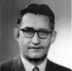


Kullback–Leibler Divergence
The KL-divergence is the penalty (in bits) you'll have to pay
if you try to compress data from one distribution
using a scheme optimized for another.
- https://en.wikipedia.org/wiki/Kullback–Leibler_divergence
- https://en.wikipedia.org/wiki/Solomon_Kullback - https://en.wikipedia.org/wiki/Richard_Leibler
Solomon Kullback (1907-1994)
Richard Leibler
(1914-2003)
Example:
To report weather in Sahara desert it is optimal to use short encoding for sunny days, because they are most frequent.
To report weather in Seattle it is optimal to use shorter messages for rainy days.
If we would use the message encoding scheme optimized for Sahara to encode messages for Seattle, we would end up with messages which are longer than needed.
sunny Sahara
More precisely:
if your data really comes from probability distribution P,
but you use a compression scheme optimized for Q,
the divergence D(P||Q) is the number of extra bits you'll require
to store a record of each sample from P.
D(Q||P) ≥ 0 because, by definition, it's the number of bits required
compared to the best possible.
Note: generally there's no reason to expect D(P||Q) to be equal to D(Q||P) .
rainy Seattle

Slide 15
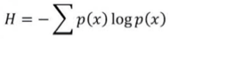
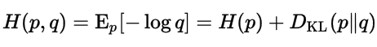
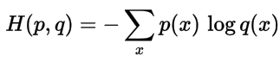
Cross Entropy
The entropy H(p) of a distribution p measures how many bits you need
on average to encode data from p with the code that is optimal for p.
The cross-entropy of a distribution p with respect to a distribution q
measures how many bits you need on average to encode data from p with the code that is optimal for q.
The cross entropy for the distributions p and q over a given set is defined as follows:
… the output vector represents a probability distribution, and cross-entropy indicates the distance between what the network believes this distribution should be, and what the teacher says it should be …
… You should use the cost function that matches your output units and your probabilistic modeling assumptions. For a multi-class classification, that means a softmax + cross entropy. For regression (assuming a Gaussian distribution) - squared error…
Cross-entropy
H(p) – entropy of p
Kullback–Leibler divergence of q from p
D(p||q) >= 0 , because it represents additional bits needed to encode data with distribution p using encoding optimal for distribution q
For discrete p & q:
Cross-Entropy is always greater than Entropy,
because D(p||q) >= 0
- https://en.wikipedia.org/wiki/Cross_entropy
- http://stats.stackexchange.com/questions/31985/definition-and-origin-of-cross-entropy
- https://www.reddit.com/r/MachineLearning/comments/3klqdh/q_whats_the_difference_between_crossentropy_and/
- https://jamesmccaffrey.wordpress.com/2013/11/05/why-you-should-use-cross-entropy-error-instead-of-classification-error-or-mean-squared-error-for-neural-network-classifier-training/

Slide 16
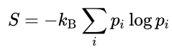
Entropy in Physics
Clausius invented the term in 1865. He had noticed that a certain ratio was constant in reversible, or ideal, heat cycles. The ratio was heat exchanged to absolute temperature. Clausius decided that the conserved ratio must correspond to a real, physical quantity, and he named it "entropy".
Rudolf Clausius
Entropy in Statistical Mechanics:
The summation is over all the possible microstates of the system.
p_{i} is the probability that the system is in the i-th microstate.
k_{B} is the Boltzmann constant, equal to 1.38065×10−23 J/K
The second law of thermodynamics states that
entropy never decreases spontaneously in an isolated system.
The total entropy of any system can't decrease
other than by increasing the entropy of some other system.
Ludwig Boltzmann
Josiah Willard Gibbs

Slide 17
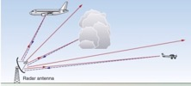
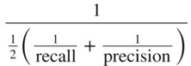
ROC Curve & Precision-Recall Curve
Receiver Operating Characteristic (ROC) curves for a binary classifier:
True Positive Rate (TPR) vs False Positive Rate (FPR)
at various threshold settings.
ROC curve was first developed by radar engineers during World War II
for quantifying the quality of detection of enemy airplanes.
TPR = REC = Recall or Sensitivity = TP/P = TP / (TP + FN)
( planes classified as planes / all planes' events)
FPR = False Positive Rate = fall-out = FP / N = FP / (FP + TN)
( noise classified as planes / all noise events )
PRE = Precision = TP/(TP+FP)
( planes classified as planes / all events classified as planes)
TNR = SPC = Specificity = TN/N = TN/(FP+TN)
(True Negative Rate)
--------------------------------------------------------------------------------
AUC = Area Under the Curve
Simply the area under the ROC curve (1 = very good, 0.5 = bad)
--------------------------------------------------------------------------------
F1 Score - a single number evaluation metric, harmonic average
of the precision and recall :
Radar detects planes.
It need to separate
"plane" signals from noise.
Planes
Noise
High Precision, Low Recall
Selecting Threshold
Low Precision, High Recall
Recall
Low Threshold
ROC
Curve
Precision-Recall
Curve
High Threshold
FPR

Slide 18
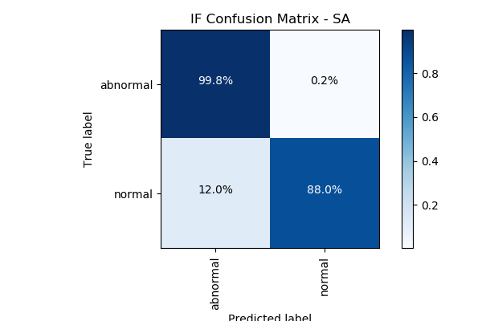
Confusion Matrix
For a simple binary classifier we are predicting one of two possibilities (Yes/No, Positive/Negative, Plane/No-Plane, Normal/Abnormal, etc.).
So we construct a 2x2 matrix to visualize True & False Positives and Negatives.
from sklearn import metrics
expected = target
predicted = model.predict(data)
metrics.precision_score(expected, predicted)
metrics.recall_score(expected, predicted)
metrics.roc_curve(expected, predicted)
metrics.roc_auc_score(expected, predicted)
metrics.confusion_matrix(expected, predicted)
[[194156 4864]
[ 23 321]]
Accuracy = sum(Diagonal) / sum(ALL) = sum(Correct) / sum(ALL)
Precision = TP / (TP+FP)
Recall = TP / (TP+FN) = TP / All_Actual_Positives

Slide 19
How to find "REGULARITY"
High Bias model
(underfitting,
model too simple)
Bias/Variance Trade-off,
Good Generalization
High Variance model
(model too complex,
overfitting - fits noise)
Overfitting and Regularization
Goal of training the model is to fit/learn a "regularity" in the data, and to avoid fitting noise (avoid overfitting).
How do we know that we are overfitting?
Let's split data into two sets:
- training
- testing
If we overfit on the training data (learn regularity and some noise specific to the training data), then accuracy measured on the test data may be bad
(model doesn't generalize well).
Solution – try to find a more "regular" solution (less noise, less overfitting).

Slide 20
Regularization:
“any modification we make to a learning algorithm
that is intended to reduce its generalization error
but not its training error.”
Motivation:
Imagine that we train network on different subsets of inputs.
For each subset we will get different model parameters.
We want to reduce the variance of these parameters between subsets.
generalization vs overfitting
“… most regularization strategies are based on regularizing estimators ...
by trading increased bias for reduced variance. An effective regularizer is one that makes a profitable trade, reducing variance significantly while not overly increasing the bias.”

Slide 21
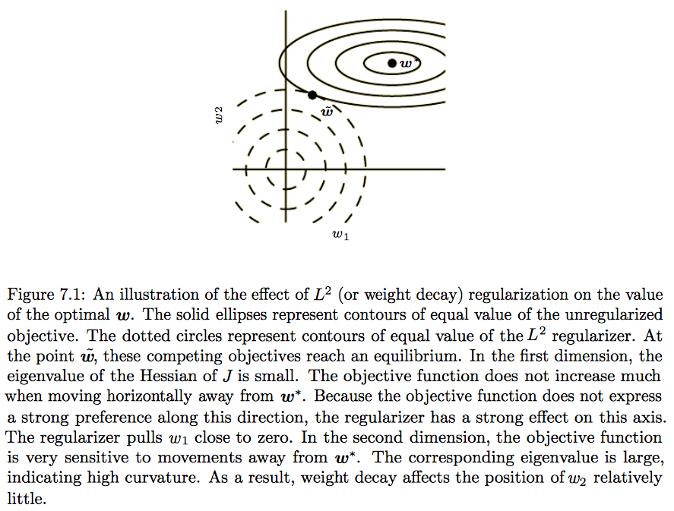
Minimum “cost”
without regularization
One way to do avoid overfitting can be to avoid big "weights" in the model.
Compromize
min(cost + penalty)
Cons: bias (shift),
Pros: low variance
Minimum of the “penalty” regularization term

Slide 22
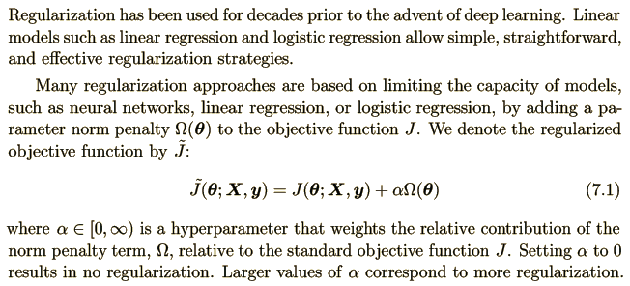
7.1. Parameter Norm Penalties
Parameter norm
penalty
Note: θ – some (sub)set of parameters.
Note: loss function is a part of a cost function which is a type of an objective function
Loss function – measures the penalty
Cost function – more general (may include regularization)
Objective function – any function you optimize during training

Slide 23
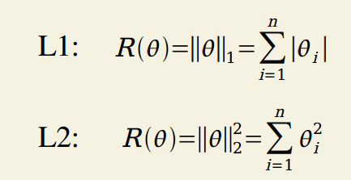
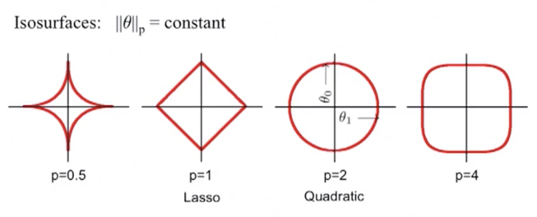
L1 & L2 Regularization
L1 norm - minimizing the sum of the absolute differences
L2 norm - minimizing the sum of the square of the differences

Slide 24
L² Parameter Regularization
L² parameter norm penalty commonly known as: “weight decay regularization”
or “ridge regression”
or “Tikhonov regularization”.
This regularization strategy drives the weights closer to the origin
by adding a quadratic regularization term to the objective function.
… the addition of this weight decay term has modified the learning rule
to multiplicatively shrink the weight vector by a constant factor on each step, just before performing the usual gradient update.

Slide 25
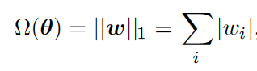
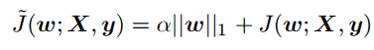
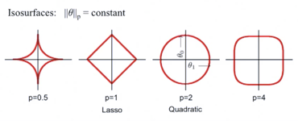
L¹ Regularization
Regularized objective function:
In comparison to L² regularization,
L¹ regularization results in a solution that is more sparse
(sparse = some parameters have an optimal value of zero).
L² regularization does not cause the parameters to become sparse, while L¹regularization may do so for large enough α.
The sparsity property induced by L¹ regularization has been used extensively
as a feature selection mechanism.
Feature selection simplifies a machine learning problem
by choosing which subset of the available features should be used.
In particular, the well known LASSO (Tibshirani, 1995) (Least Absolute Shrinkage and Selection Operator) model
integrates an L¹ penalty with a linear model and a least squares cost function. The L¹ penalty causes a subset of the weights to become zero,
suggesting that the corresponding features may safely be discarded.

Slide 26
Regularization – Generating Data (Dataset Augmentation)
Idea – generate fake data and add it to the training data set.
Example for images: shift images several pixels in all directions, slight rotation, or slight scaling. (but be careful – certain transformation can change the meaning: ‘b’ and ‘d’ , ‘6’ and ‘9’).
Example - training AlphaGo Zero – self-play - playing against itself.
Example - training self-driving car algorithm using simulator (driving inside randomly generated virtual world).
Injecting noise - another form of data augmentation. Can be applied to the inputs, to the hidden units, to the weights, to output targets.
Dropout - also good technique.

Slide 27
Regularization - Early Stopping.
When training large models with sufficient representational capacity to overfit the task, we often observe that training error decreases steadily over time,
but validation set error begins to rise again.
Every time the error on the validation set improves, we store a copy of the model parameters, so that we can go back to them and stop training.
This is called “Early stopping”.
Early stopping requires a validation set, which means some training data is not fed to the model. To best exploit this extra data, one can perform extra training after the initial training with early stopping has completed. In the second, extra training step, all of the training data is included.

Slide 28
Regularization - Bagging and Other Ensemble Methods
Bagging (short for bootstrap aggregating) is a technique for reducing generalization error.
This is done by separately training several different models and then combining them. Each model then votes on what it thinks the best output is.
A general term for this is model averaging.
Bagging is a type of ensemble method.
The reason we use bagging is that different models often have varying degrees of generalization and test error.
Machine Learning contests are often won using methods of model averaging over dozens of models.

Slide 29
Regularization - Dropout
Dropout - a regularization technique for neural network models proposed by Srivastava, et al, 2014. Dropout is a technique where randomly selected neurons are ignored during training. They are “dropped-out” randomly (by specifying a random mask vector).
Dropout provides an inexpensive approximation to training and evaluating a bagged ensemble of exponentially many neural networks. Typically, Dropout can have good performance with only 10-20 of its exponentially many models that are averaged together using the geometric mean of the output.
Weight Scaling Inference Rule: Make sure the expected total input to a unit at test time is roughly the same as the expected total input to that unit at train time. One example is randomly removing any given weight from the model 50% of the time and then dividing the values of each weight by 2 at end of training or multiply the weights by 2 during training.
Dropout is computationally cheap and usually more eﬀective than other standard computationally inexpensive regularization methods such as weight decay, ﬁlter norm constraints and sparse activity regularization.
Dropout may also be combined with other forms of regularization to yield a further improvement.
Dropout works well with nearly any model that uses a distributed representation and can be trained with stochastic gradient descent.

Slide 30
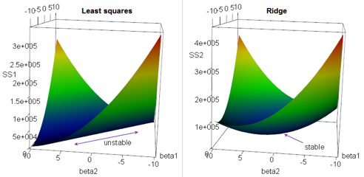
Regularization: Ridge Regression
Multivariate (multiple) Linear Regression Regularization.
Suppose we have a OLS (Ordinary Linear Squared) regression where two parameters x1 & x2 are not orthogonal, but are equal, proportional to each other, or highly correlated. Then there may be an infinite number of coefficients which will fit the model.
For example, (a*x1 - x2), (100*a*x1 - 100*x2), etc.
If we are trying to minimize the cost function in the multidimensional
space of coefficients, we will get an infinite diagonal groove (ridge)
for a*x1 = x2. Any place at the bottom of this ridge is equally good for us.
So we will get a big variability in possible values of coefficients for x1 & x2.
In other words, the solution will be unstable.
We can reduce this variability by adding additional regularization factor to the loss function as a sum of squares of coeffitients. When we minimizing this expression, bigger "lambda" value will cause smaller "beta" values, thus keeping the coefficients "beta" from becoming too large.
This is called "Ridge Regression".
It changes the infinitely long ridge into a local minimum.
Why Ridge Regression is called Ridge ...

Slide 31
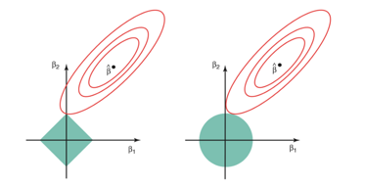
Regularization - LASSO, Elastic Net
In Ridge Regression we add a "regularization" term as sum of squares (L2 norm).
In LASSO Regression we add a "regularization" term as sum abs values (L1 norm).
LASSO = Least Absolute Shrinkage and Selection Operator.
LASSO favors solutions on the tips of the bounding surface for coefficients, where some of coefficients are zero. Thus it favors "sparse" solutions.
Elastic Net - A combination of Ridge Regression and LASSO.
Why LASSO favors sparse solutions

Slide 32
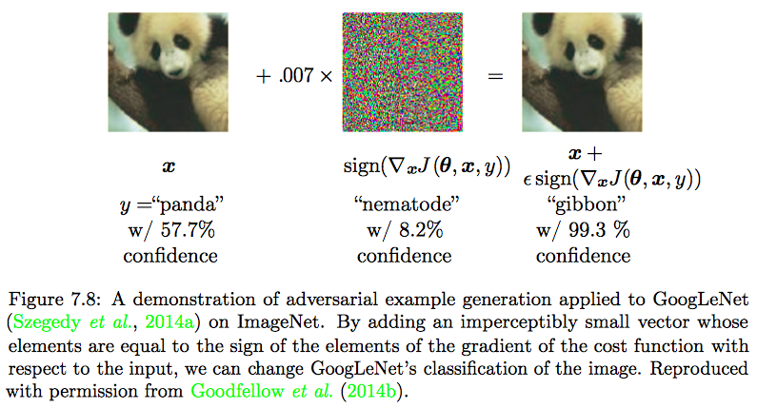
Regularization - Adversarial Training
Problem: if a network consists of primarily linear elements, small changes to the input data may cause large errors in the output.
Solution: train your network using injected randomness.

Slide 33
Regularization – Evolutionary (Meta) Learning
Meta Learning = learn to learn
For example, automatically find the best model architecture and hyperparameters (Meta-parameters).
Search for optimum in a multi-dimensional space of architectures and hyperparameters (Meta-Space).
We can optimize for different things - accuracy, generalization, speed, power-effectiveness, etc.
Random search is slow.
Evolutionary approach is much faster.
It is similar to Gradient Descent in the space of hyper-parameters.
Idea – let models change and compete, select the best, repeat.
Similar to Darwinian evolution in biology.
Examples of random "mutations": remove a convolution, add skip connection, change learning rate, etc.
Combinations - analogous to genetic recombination - combining genes (hyperparameters) of two parents.
Many groups are working on the subject:
- OpenAI (Reptile, MAML)
- Uber Labs ( differentiable plasticity )
- Sentient Labs (evolutionary optimization of gated networks (LSTMs) for language modeling)
- Google DeepMind
- Google Brain AutoML, Amoebanet, AdaNet
- H2O.ai - AutoML and Driverless AI
Charles Darwin

Slide 34
Back Propagation
Forward Propagation:
From input – calculate activations of nodes in 1st layer
From 1st layer – calculate activations in 2nd layer
etc.
(note - cache activations, will need them for backprop)
Calculate the output – and loss/error E
(E ~ diff between calculated and target values)
Backpropagation (backprop, BP) is a method used in artificial neural networks to calculate a gradient that is needed in the calculation of the weights to be used in the network.
Backpropagation computes gradients using the chain rule.
Backward propagation:
Calculate dE/dW[ij] for all layers using the chain rule
calculate layer by layer going backwards
using cached activations from forward pass

Slide 35

Back Propagation
1970
Seppo Linnainmaa
Retired since 2007 Past: University of Helsinki, University of Maryland, Chairman of Finnish AI, Research Professor at the Technical Research Centre of Finland. Best known for creating the modern version of back propagation. Was first published in his 1970 master's thesis.
- https://en.wikipedia.org/wiki/Backpropagation
- http://people.idsia.ch/~juergen/who-invented-backpropagation.html

Slide 36
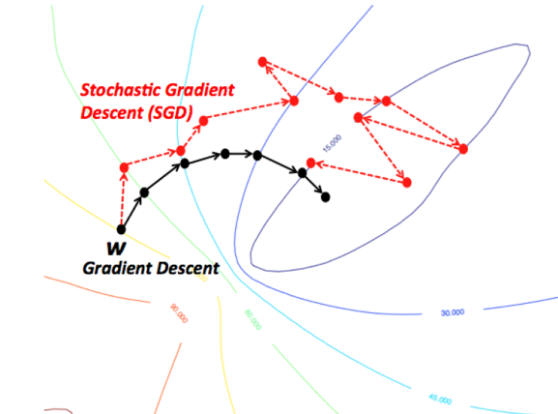
Stochastic Gradient Descent (SGD)
- https://en.wikipedia.org/wiki/Stochastic_gradient_descent
Computing true gradient is expensive when number of dimensions is large. Solution – SGD: each step we calculate gradient for a small random subset of dimensions. Each step is much “cheaper” to calculate.

Slide 37
Stochastic Gradient Descent
1998
Léon Bottou
Introduced stochastic gradient descent in 1998
Bottou, Léon (1998). "Online Algorithms and Stochastic Approximations".
At Facebook Research since 2015
Past: AT&T Bell Laboratories, AT&T Labs, NEC Labs America, and Microsoft Research.
- https://research.fb.com/people/bottou-leon/
- http://leon.bottou.org
- https://scholar.google.com/citations?user=kbN88gsAAAAJ

Slide 38
SGD = Stochastic Gradient Descent
Stochastic Gradient Descent is a variation of the gradient descent algorithm that calculates the error and updates the model for each example in the training dataset – but using only random subset of dimensions.
Pros: frequent updates, simple to understand, faster learning, noise helps to avoid local minima (premature convergence). Cons: noisy gradients can cause errors, can be computationally expensive.
Batch Gradient Descent - calculates the error for each example in the training dataset, but only updates the model after all training examples have been evaluated.
Pros: fewer updates to the model – less calculations. More stable gradient. Easy to do parallel processing. Cons: more stability can lead to premature convergence. Additional complexity of accumulating prediction errors across all training examples – can require more memory. model updates may become very slow for large datasets.
Mini-batch Gradient Descent – a compromise. It splits the training dataset into small batches that are used to calculate model error and update model coefficients.
Mini-batch size is usually tuned based on number of CPUs or GPUs and memory size. Common default is 32. Common values are powers of 2 (32, 64, 128, 256, etc.)

Slide 39
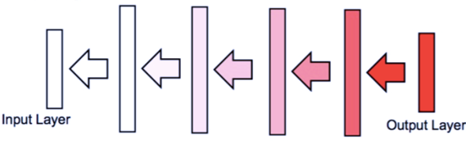
Vanishing Gradient Problem
Solutions to Vanishing Gradient Problem
Multi-level hierarchy (Jürgen Schmidhuber, 1992) – pre-training one level at a time. Similar approach - Hinton et al. (2006) - deep belief network model, training one layer at a time.
Gated nodes - LSTM = Long Short-Term Memory (Hochreiter & Schmidhuber, 1997, winning in 2009) and GRU (Gated Recurrent Unit, 2014).
Residual networks (Microsoft ResNets, 2015) – adding skip-connections between remote layers helps to eliminate the problem.
Faster hardware – helps.
Using ReLU activation function helps, because they only saturate in one direction.
Other methods:
- rely only on sign of the gradient (not on the value).
- using random search or genetic algorithm instead of gradient.
Using backpropagation we calculate gradients
layer by layer going backwards.
Those gradients are calculated using chain rule.
dW[m] = dW[N] * dW[N-1] * ...
If gradients are small, and number of layers is large, the result of multiplying multiple small numbers becomes vanishingly small. This may effectively prevent some weights from changing their value.

Slide 40
Dynamic Learning Rate
Main idea – to change/adapt individual learning rates
for model parameters during training.
Most common algorithm – ADAM (Adaptive Moment Estimation, 2014).
Choosing the Right Optimization Algorithm – there is no consensus!
Generally, using whatever is most familiar to the user is preferred.
The most common ones:
- Stochastic Gradient Descent (SGD)
- SGD with momentum
- RMSProp
- RMSProp with momentum
- AdaDelta (see https://arxiv.org/pdf/1212.5701.pdf )
- Adam

Slide 41
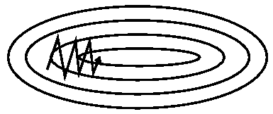
SGD - Stochastic Gradient Descent
… it is common to decrease the learning rate linearly until iteration certain τ, and after that keep it constant (usually at ~1% of the initial value). SGD has trouble navigating ravines, i.e. areas
where the surface curves much more steeply in one dimension than in another (it oscillates across the slopes
of the ravine while only making hesitant progress along the bottom towards the local optimum).
-- AdaGrad - Adapts the learning rates of all model parameters by scaling them inversely proportional
to the square root of the sum of all of their historical squared values.
Problem - accumulation of squared gradients from the beginning of training can result in a premature and excessive decrease in the effective learning rate.
--
RMSProp - Changing the gradient accumulation into an exponentially weighted moving average.
It is similar to AdaGrad but performs better in non-convex scenarios. Eﬀective and practical. One of the go-to optimization methods. -- Momentum - (Polyak, 1964) - accumulates an exponentially decaying moving average of past gradients and continues to move in their direction. Physical analogy: the negative gradient is a force moving a particle through parameter space. We assume unit mass (m=1), so the velocity vector v may also be regarded as the momentum of the particle. People actually use two forces:
One force is proportional to the negative gradient of the cost function. We can think of the particle as being like a hockey puck sliding down an icy surface. Whenever it descends a steep part of the surface, it gathers speed and continues sliding in that direction until it begins to go uphill again.
Second force - viscous drag resistance proportional to –v(t). This force is necessary, because without it the particle will never stop.
--
Nesterov Momentum - the gradient is evaluated after the current velocity is applied (thus correcting the standard method of momentum).
--
Adam – (Adaptive Moment Estimation) - a variant on the combination of RMSProp and momentum.
--

Slide 42
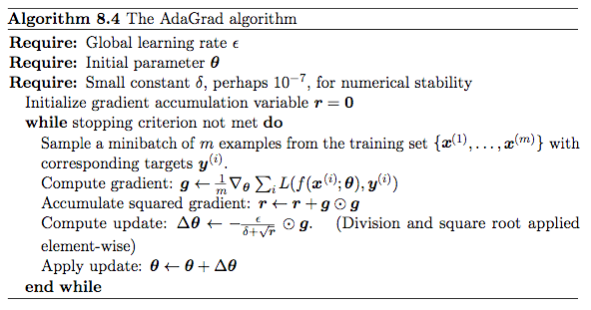
AdaGrad
Adapts the learning rates of all model parameters by scaling them inversely proportional to the square root of the sum of all of their historical squared values.
Problem - accumulation of squared gradients from the beginning of training can result in a premature and excessive decrease in the effective learning rate.

Slide 43
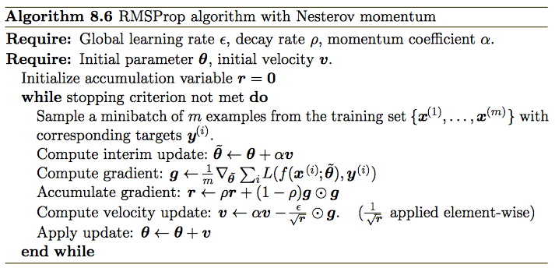
RMSProp
Changing the gradient accumulation into an exponentially weighted moving average.
Similar to AdaGrad but performs better in non-convex scenarios.
Eﬀective and practical. One of the go-to optimization methods.

Slide 44
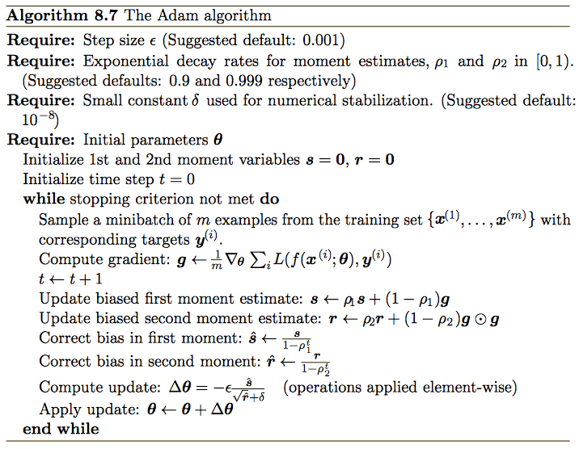
Adam
Adam – “Adaptive Moments” - a variant on the combination of RMSProp and momentum.
Momentum is incorporated directly as an estimate of the first order moment (with exponential weighting) of the gradient. The most straightforward way to add momentum to RMSProp is to apply momentum to the rescaled gradients.
Adam includes bias corrections to the estimates of both the first-order moments (the momentum term) and the un-centered second-order moments to account for their initialization at the origin.

Slide 45
Adam “Adaptive Moments”
(Diederik P. Kingma, Jimmy Ba, 2014) – an algorithm for first-order gradient-based optimization
of stochastic objective functions, based on adaptive estimates of lower-order moments
- https://arxiv.org/abs/1412.6980
- https://arxiv.org/pdf/1412.6980.pdf
Adam is a variant on the combination of RMSProp and momentum.
Momentum is incorporated directly as an estimate of the first order moment
(with exponential weighting) of the gradient.
The most straightforward way to add momentum to RMSProp is to apply momentum to the rescaled gradients.
Adam includes bias corrections to the estimates of both the first-order moments (the momentum term)
and the un-centered second-order moments to account for their initialization at the origin.
Adam is explained by Andrew Ng in Coursera Deep Learning specialization Courser 2 Week 2 Lecture 8 (C2W2L08):
- https://www.youtube.com/watch?v=JXQT_vxqwIs

Slide 46
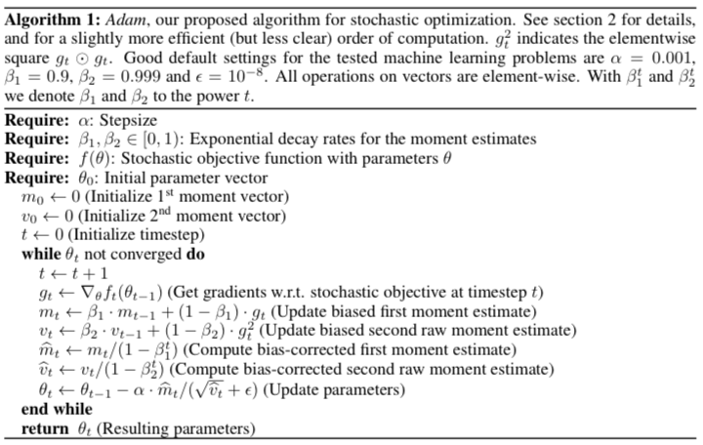
From original paper - https://arxiv.org/pdf/1412.6980.pdf

